Slide 1
MassMutual DSDP 2018: Introduction to Data Visualization
June 15, 2018
R. Jordan Crouser
Assistant Professor of Computer Science
Smith College

Slide 2

Introductions & background
Jordan
(he / him)
2017 on: Asst. Prof. in CS (Smith)
2015 to 2017: Visiting Asst. Prof. in SDS (Smith)
2013 – 2015: Research Scientist (MITLL)
2010 – 2013: PhD in Visual Analytics (Tufts)
2008 – 2010: MSc in Educational Tech. (Tufts)
2004 – 2008: BA in CS and Math (Smith)
For more info, visit:
www.science.smith.edu/~jcrouser

Slide 3





What I do: analytical tools for messy data

Slide 4
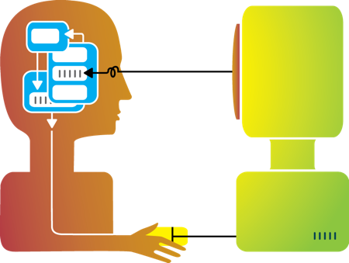
Big idea behind my research
Humans and machines have complimentary strengths
Visualization
Perception
and
context
Interaction
Computational power
Image credit: Ali Ansari

Slide 5
Focus of this workshop
How do we build visualizations that help humans understand patterns in data?
Visualization
Image credit: Ali Ansari

Slide 6
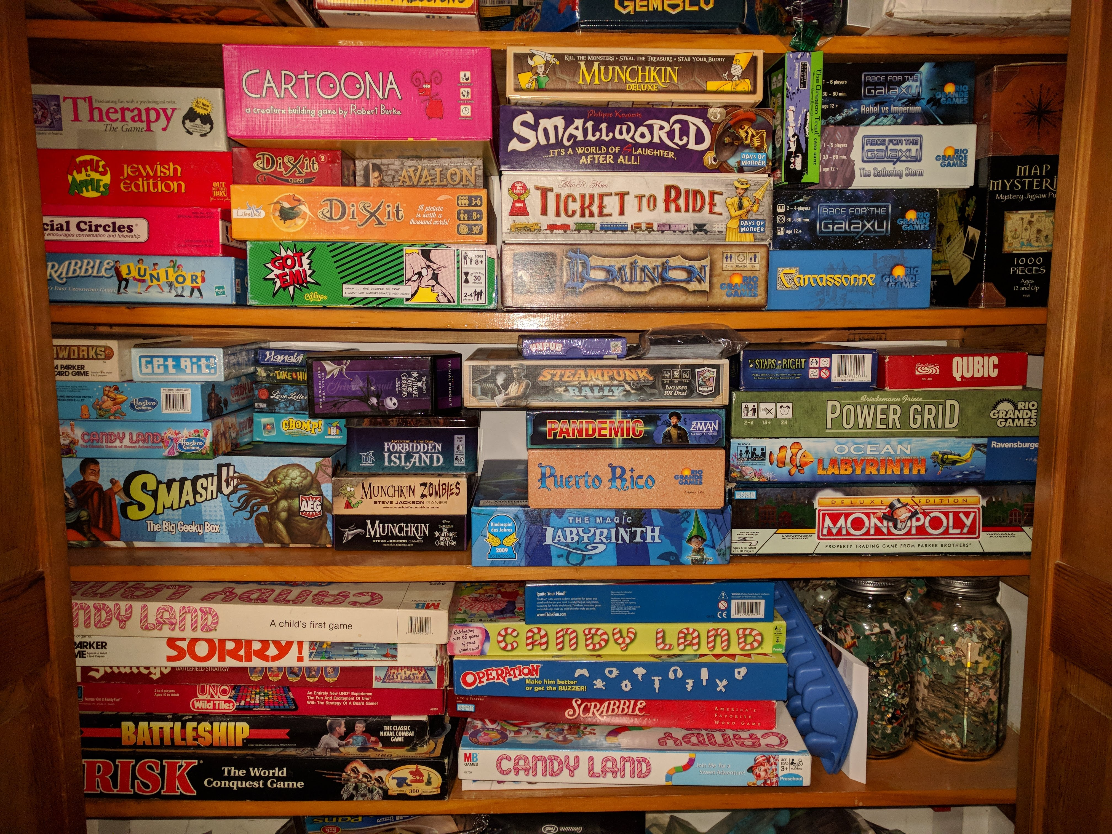
Interesting (non-CS) thing to know about me
I’m a big
board game
nerd
(we have a closet
in our house
dedicated to them)
Notes:
18 coral
12 bony fish
10 invertebrates
8 anemone
4 sponge
3 copepods

Slide 7

Way more interesting thing
“…I might come to visit later this summer,
I have lots of thoughts on data vis!”
Logan
(10 months old)

Slide 8
3-minute biographies
About you:
Your name and pronouns
Your alma mater
Your major / area of focus
3 questions:
What brought you to DSDP?
What’s one big thing you hope to get out of it?
What's one thing about life after graduation that you find particularly challenging / anxiety-provoking?
-or-
What’s one thing about you that would probably surprise us?

Slide 9
Outline
Introductions
Visualization overview
Flashback to early experiences in data wrangling
Visualization (def.)
Data (def.)
Graphical primitives
Visual dimensions
Pre-lunch activity: mapping visual to data dimensions
After lunch: ggplot2 crash course

Slide 10
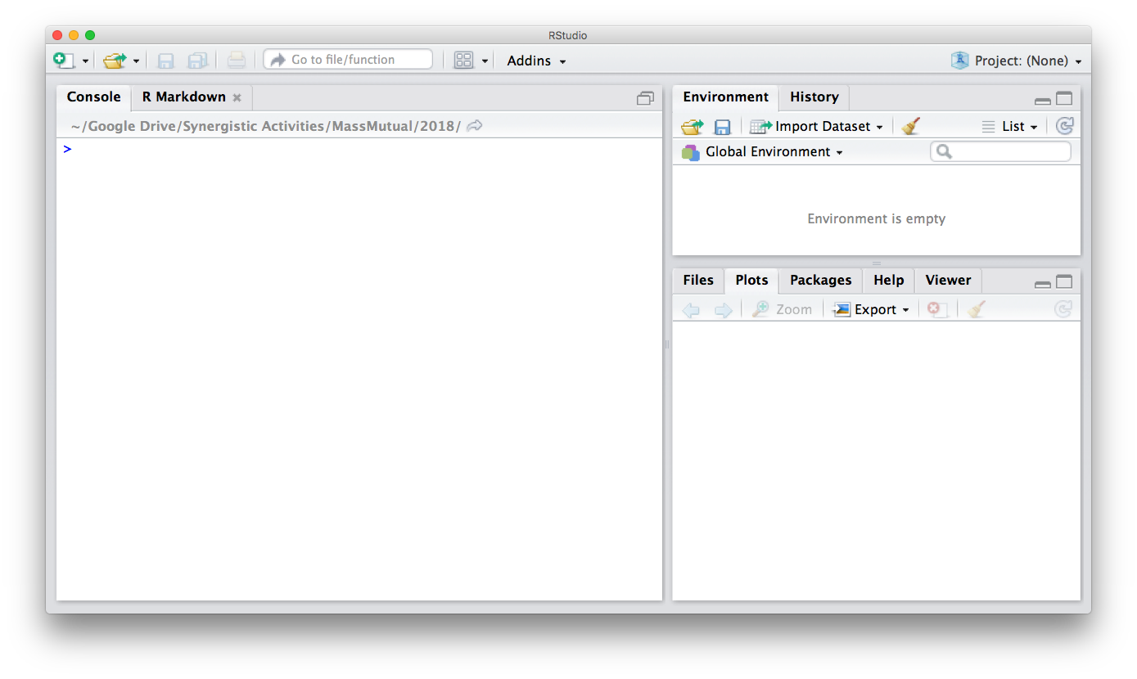
Flashback…

Slide 11
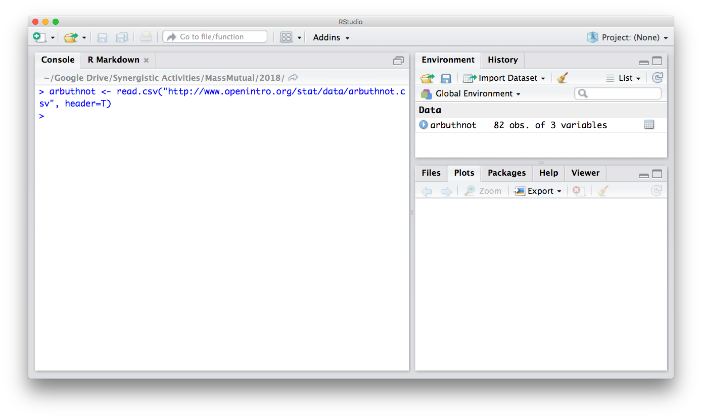
Flashback…

Slide 12
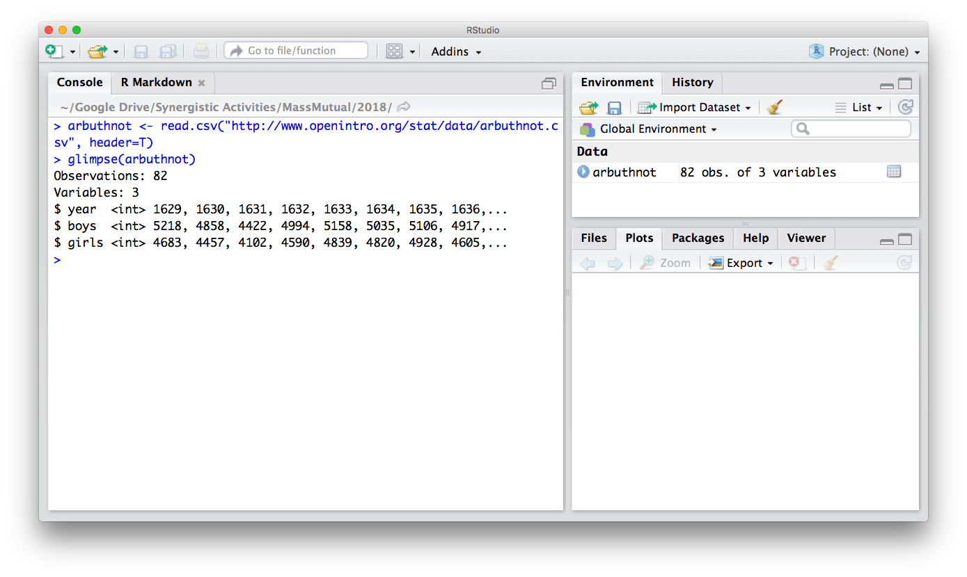
Flashback…

Slide 13
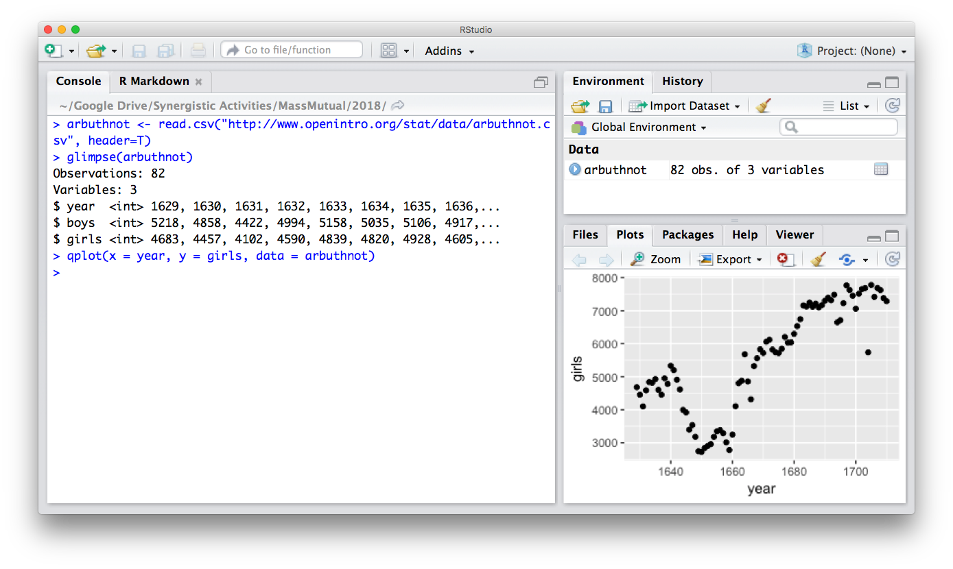
Flashback…

Slide 14
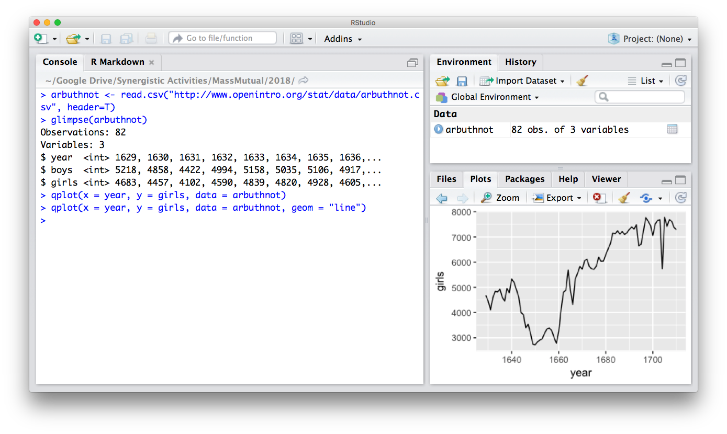
Flashback…

Slide 15

Question
What makes these
“visualizations” useful?

Slide 16
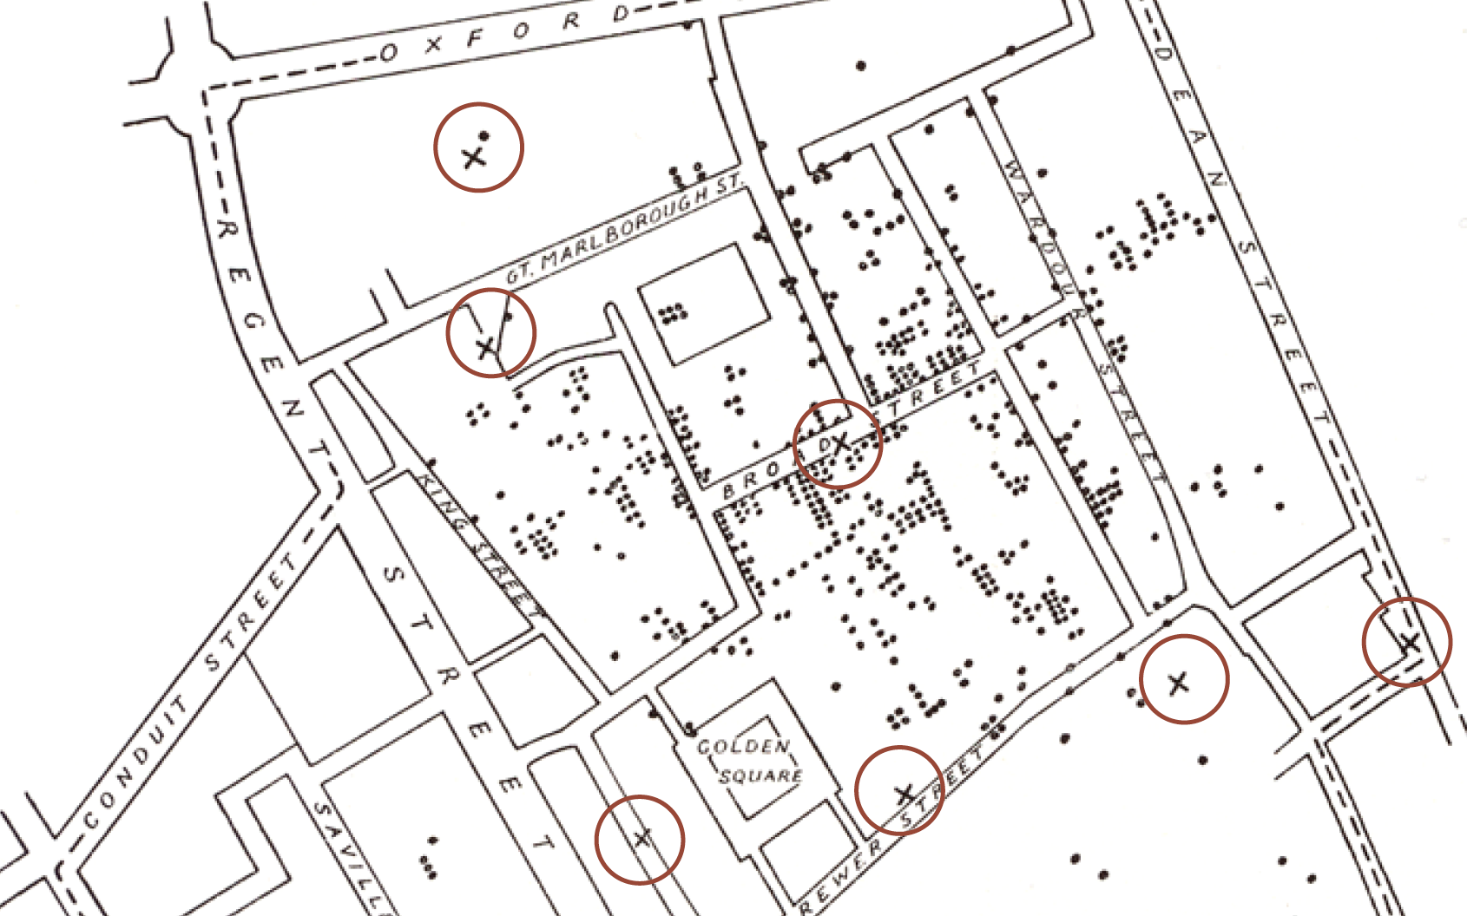
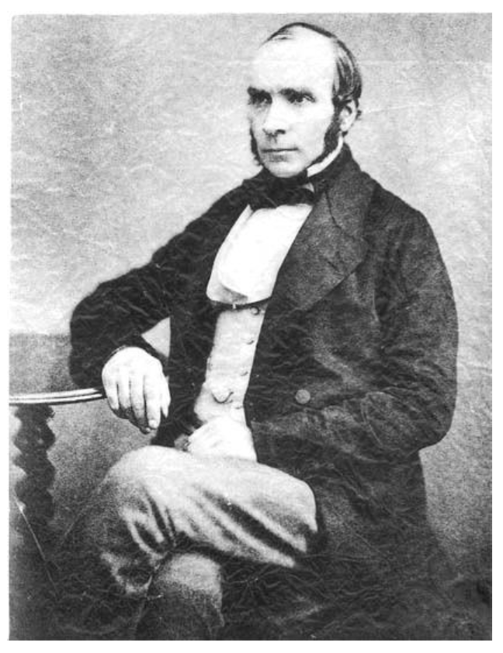
Do they help you spot trends?
In 1854, cholera broke out in London
127 people near Broad St. died within 3 days
616 people died within 30 days
Initial explanation:
“Miasma in the atmosphere”
Dr. John Snow was the first to link the outbreak to contaminated water
How did he do it?
Talked to local residents
Identified a water pump as a likely source
Used maps to illustrate his theory
Convinced authorities to disable the pump
More info here: http://en.wikipedia.org/wiki/1854_Broad_Street_cholera_outbreak

Slide 17
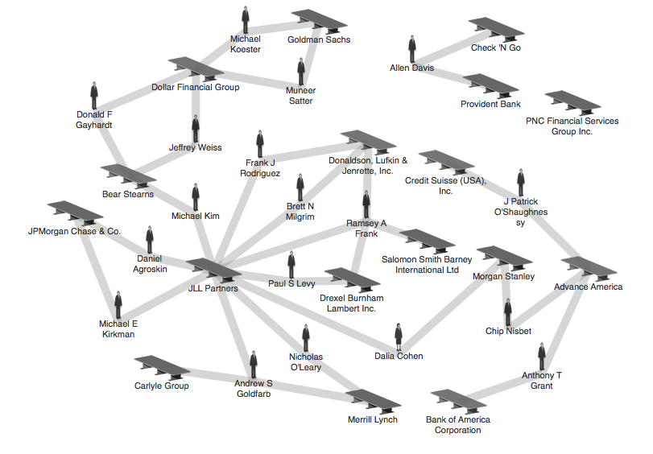
Do they help you explore?
Credit: theyrule.net

Slide 18

Do they tell a story?
Hans Rosling’s 200 Countries, 200 Years, 4 Minutes – The Joy of Stats – BBC Four
https://www.youtube.com/watch?v=jbkSRLYSojo

Slide 19
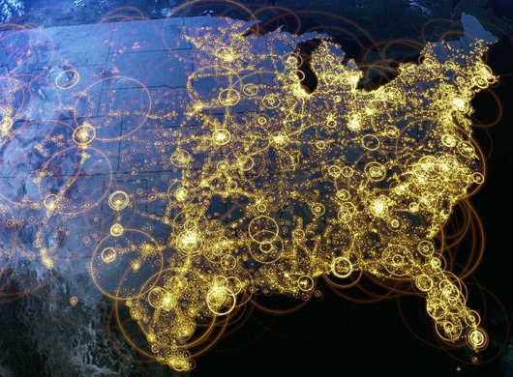
Visualization (def.)
Visual representations of data that reinforce human cognition
Notes:
Image from StackOverflow: http://i.stack.imgur.com/hbO8v.jpg

Slide 20

Data (def.)
a set of variables that capture various aspects of the world:
Tuition rates,
enrollment numbers,
public vs. private, etc.

Slide 21

Data (def.)
and a corresponding set of observations (a.k.a. records) over these variables. For example:
tuition = $46,288,
enrollment = 2,563,
private, etc.

Slide 22
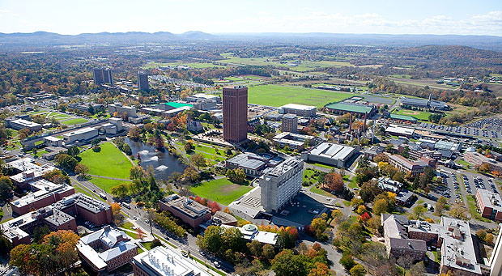

Data (def.)
and a corresponding set of observations (a.k.a. records) over these variables. For example:
tuition = $16,115,
enrollment = 28,635,
public, etc.

Slide 23
One way to think about this:
VARIABLES
 | Tuition | Enrollment | Public vs. Private | …
Smith College | $46,288 | 2,563 | private
UMass Amherst | $16,115 | 28,635 | public
Hampshire College | $48,065 | 1,400 | private
Mount Holyoke College | $43,886 | 2,189 | private
Amherst College | $50,562 | 1,792 | private
⋮
OBSERVATIONS

Slide 24
Why is this important?
Data have dimensions
Visualizations have dimensions, too
To build visualizations, we need to map data dimensions to visual dimensions

Slide 25
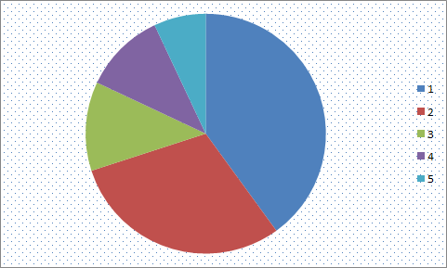
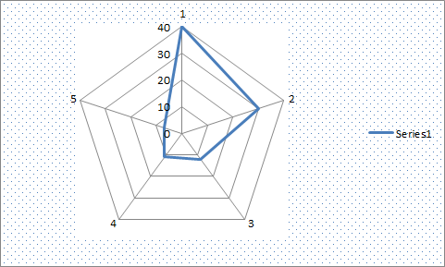
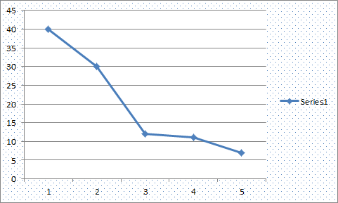
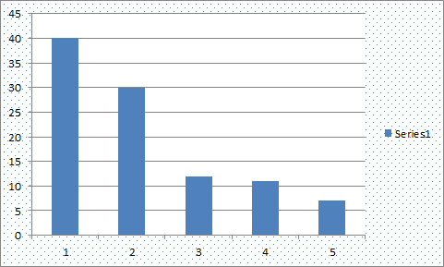
Key question for this workshop
Which data dimension should be mapped
to which visual dimension?

Slide 26
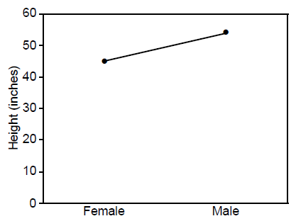
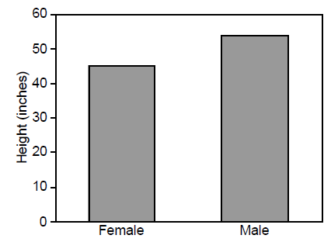
Answer: it depends
Average Height for Youth Sports Participants
Crew Basketball
Crew Basketball

Slide 27
So what do we have to work with?
Image credit: Ali Ansari

Slide 28

Graphical primitives
The images we draw are composed of marks: like ink
Lines
Points
Areas

Slide 29
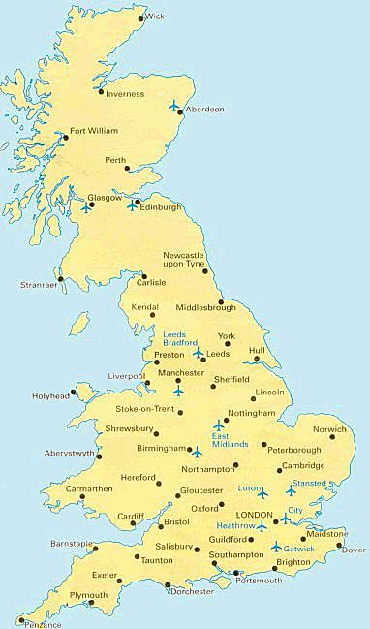
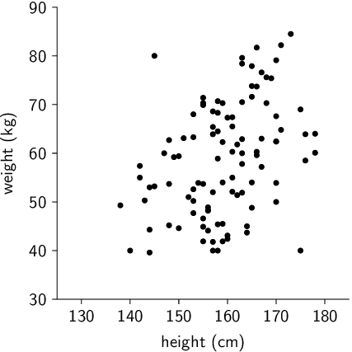
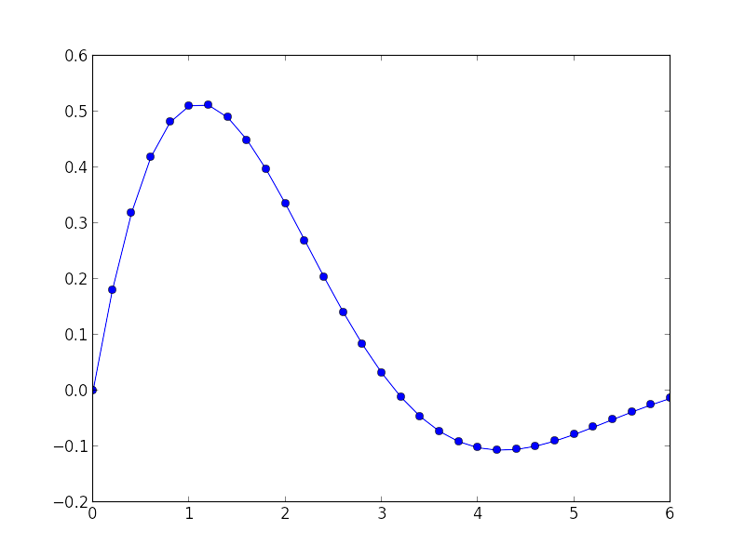
Visual dimension: position
Encode information using where the mark is drawn
Some examples:

Slide 30
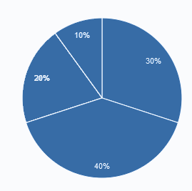
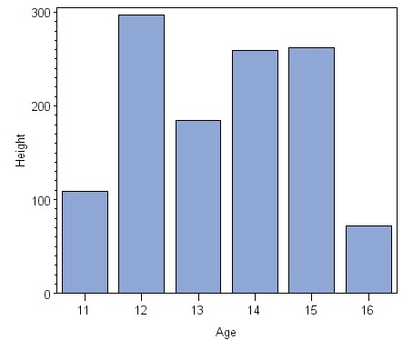
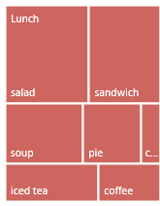
Visual dimension: size
Encode information using how big the mark is drawn
Examples:

Slide 31
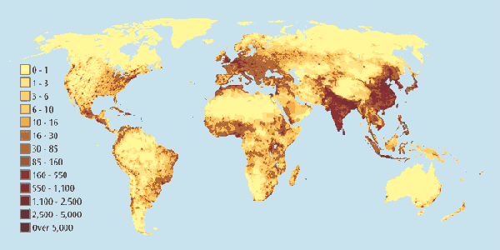
Visual dimension: value
Encode information using how dark the mark is drawn
Example:

Slide 32
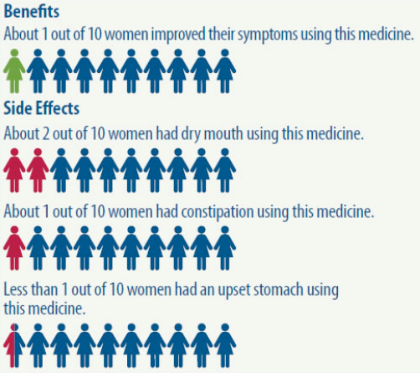
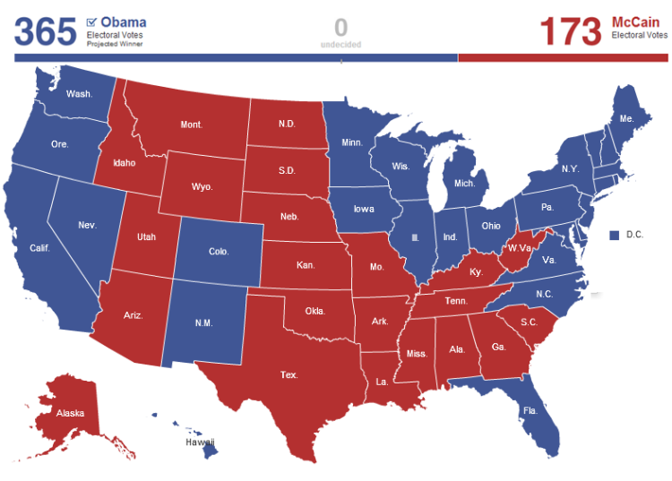
Visual dimension: color
Encode information using the hue of the mark
Examples:

Slide 33
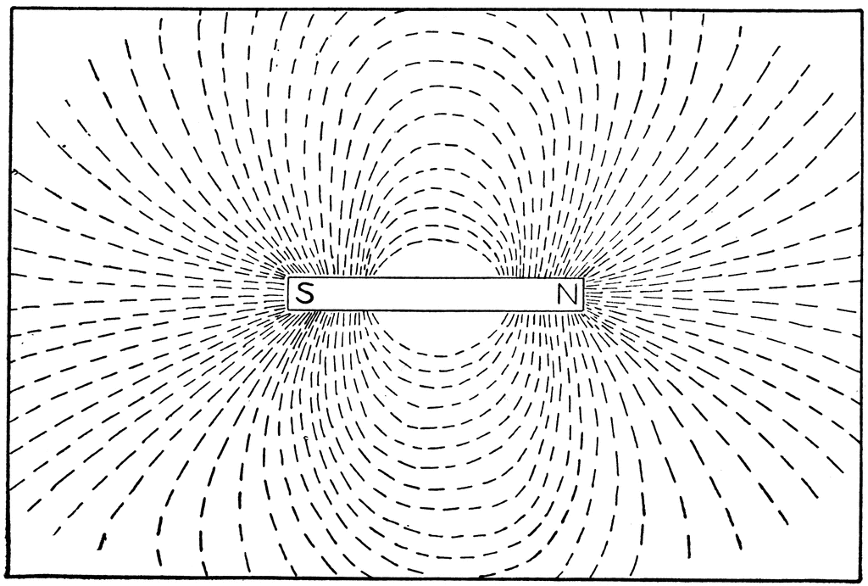
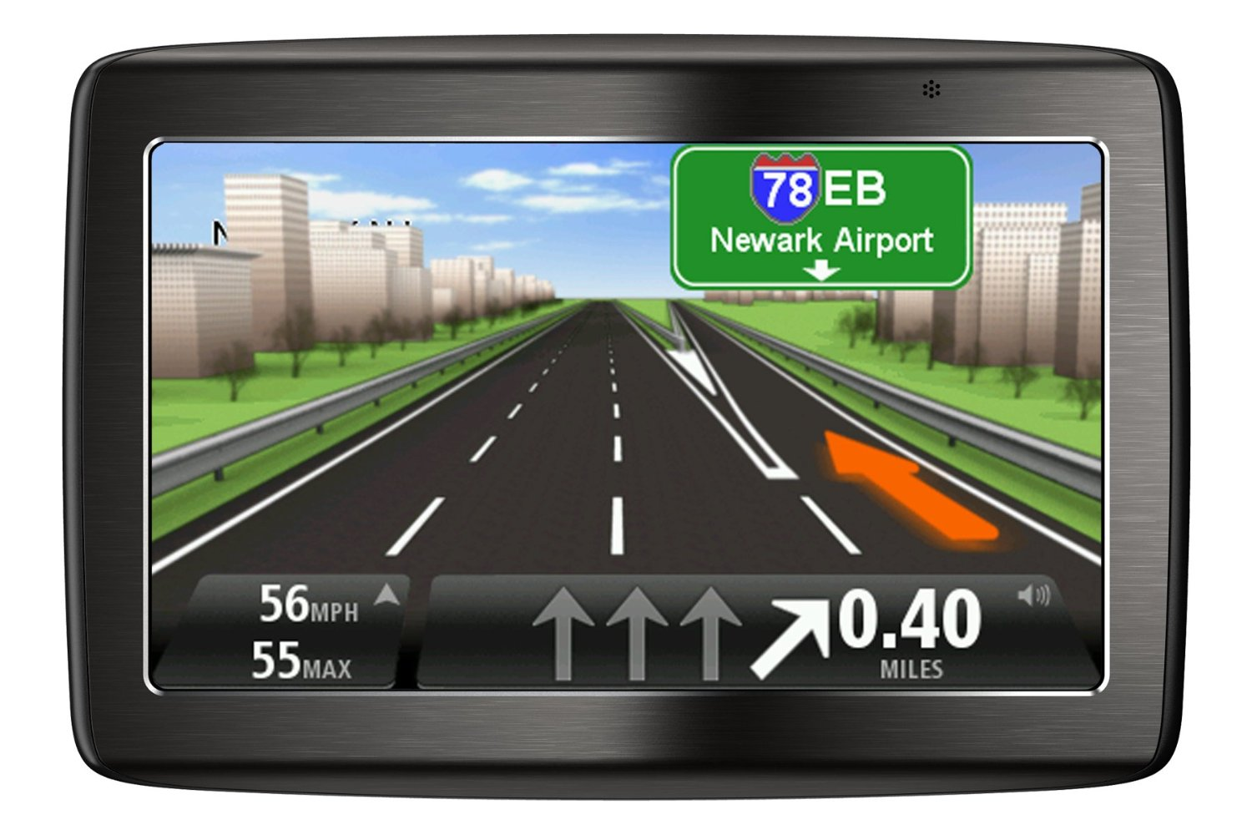
Visual dimension: orientation
Encode information using how the mark is rotated
Examples:

Slide 34



Visual dimension: shape
Encode information using how the mark is shaped
Examples:

Slide 35
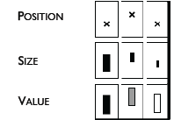
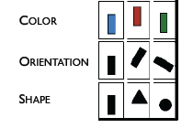
Discussion: visual dimensions & data type
Categorical Numerical
Jacques Bertin, Semiologie Graphique (Semiology of Graphics), 1967.

Slide 36
Pre-lunch activity: deconstructing graphics
Find a data visualization you think is interesting
Some ideas: NYTimes, VisualisingData.com, Visual.ly
Remember to cite your source!
Identify the following:
What is the data that’s being visualized? Where did it come from?
Which data dimensions are mapped to which visual dimensions?
How does this shape your understanding of the data?
If you liked the visualization: what is it doing well?
If you disliked the visualization: what would you change?

Slide 37
After lunch
Mini-lecture and lab: building data graphics with ggplot2
TODO (if you haven’t already):
> install.packages(‘ggplot2’)

